Slide 1
Module 3: Intro to Docker
Jim Cheshire, Sr. Escalation Engineer – Beta

Slide 2
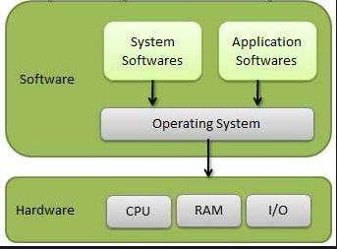
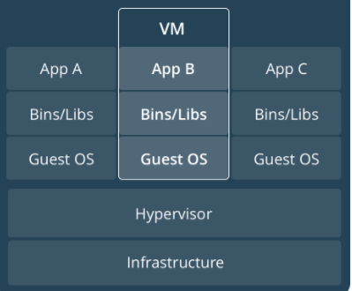
Introduction to Containers
A step back to how we used to deploy:

Slide 3
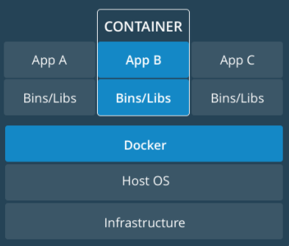
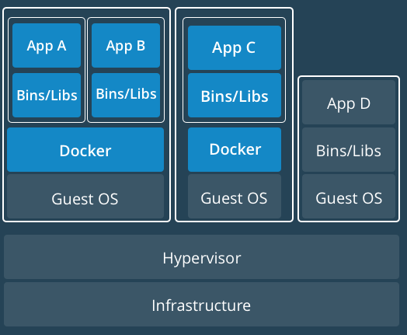
Introduction to Containers (Continued)
Deploying with Containers
Single Host VM-based

Slide 4
What is a Container?
Software that encapsulates code, runtime, system tools/libraries, and settings.
Build once and run anywhere, regardless of underlying OS. (The container runs in its own OS.)
Isolate applications from one another and underlying infrastructure.
Very secure to run.
Most popular container is Docker.
A couple of others are Rkt and Garden.

Slide 5
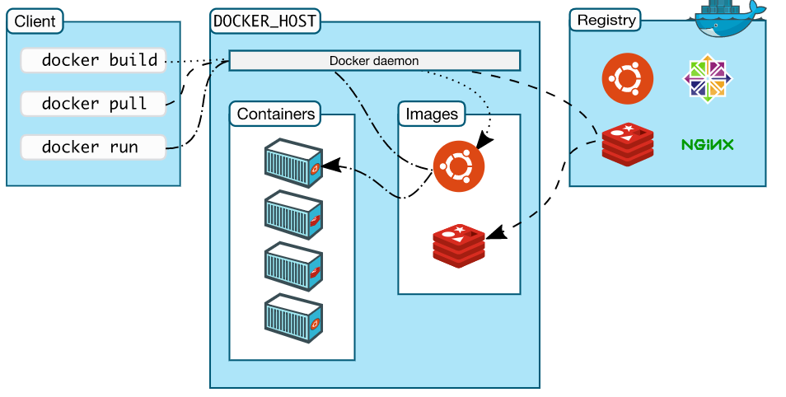
Docker
Most popular and used platform for developing, shipping and running containers
Components that enable Docker
Client (docker cli)
Docker Host
Daemon
Containers
Images
Registry (Image repository)

Slide 6
Docker (continued)
Uses Go Language
Each container has these namespaces:
Process isolation (pid)
Networking (net)
Inter-process communication (ipc)
File system mounts (mnt)
Kernel and version identifiers (uts)
Control Groups
Limit an application to a specific set of resources.
Union File Systems
File systems that operate by creating layers, making them very fast.

